Slide 1

Intoduction
Final Project
Credit Risk
Assessment
Muhammad Gilang Mahardika
ID/X Partner ingin membangun model yang dapat memprediksi credit risk menggunakan dataset yang disediakan oleh company yang terdiri dari data pinjaman yang diterima dan yang ditolak.

Slide 2




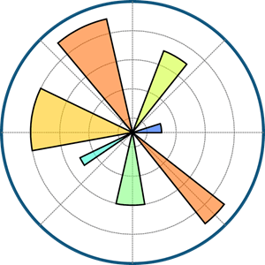



Problem
Case Study
The company need help in assessing credit risk, and to accurately predict the likelihood of a borrower defaulting on a loan.
Challenges
Develop a machine learning model to accurately assess credit risk, aiding in informed lending decisions.
Tools & Library Used
Dataset
loan_data_2007_2014.csv

Slide 3

Data Cleaning

Slide 4
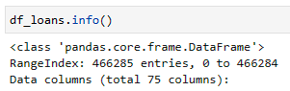
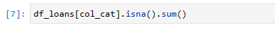
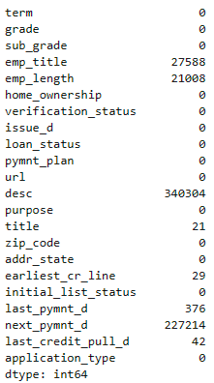
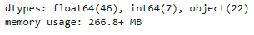
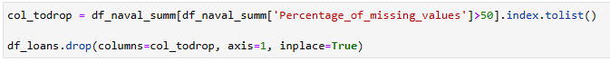
Dataset Info
Missing Values
There are a total of 8 categorical and 32 numerical columns with missing values.
Handling Missing Values
Duplicate Row
Dataset consist of 466284 rows and 75 columns.
There are 3 columns dtypes found, float, int, and object.
Based on dtypes, columns are separated to make further processing and analysis easier.
Drop columns with more than 50% of their values missing.
Missing values within numerical columns are replaced with median.
Missing values within categorical columns are replaced with mode.
There are no duplicate rows
Through observation, some columns are deemed unnecessary and preemptively dropped, this decision was based on their description and the values contained within them.

Slide 5
Exploratory Data Analysis (EDA)

Slide 6
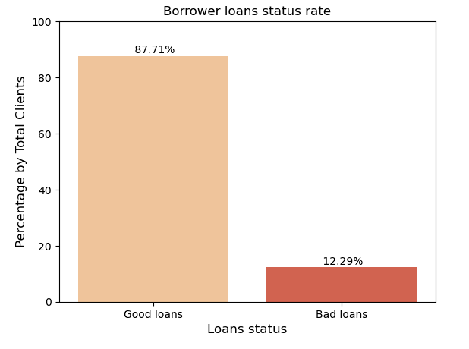
Exploratory Data Analysis
Borrower with good loans are considerably much higher in percentages reaching 87.71% than those with bad loans, indicating that the company as a lender has good loan product performance and also has good risk management and assessment.
12.29% of borrower are in bad loans status, this would indicates that the company might need to learn the behavior of borrower more deeply and be more strict when accepting loans application.

Slide 7
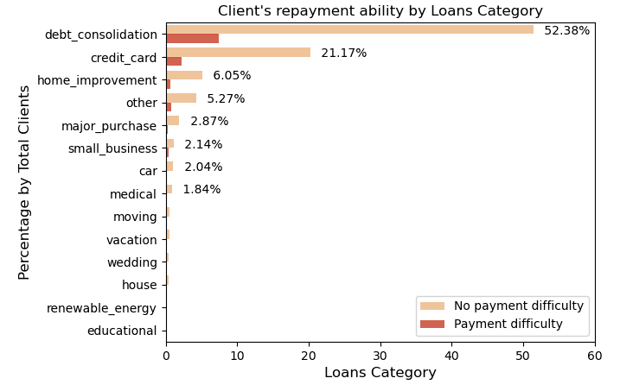
Exploratory Data Analysis
52.38% of clients that do not have payment difficulty are in the loans category of debt consolidation, followed second by loans category credit card 21.17%.
Debt consolidation is when a client taking out a new loans to pay off other existing loans.
Most clients without payment issues (52.38%) choose debt consolidation loans for their longer repayment terms, despite potentially paying more interest over time. This strategy can significantly reduce monthly payments.
Credit card loans are popular in the loans category due to their quicker application processes and approvals, making them attractive for immediate or unexpected expenses.

Slide 8
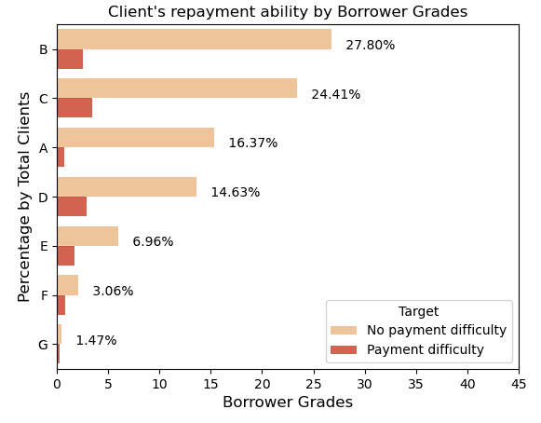
Exploratory Data Analysis
Grade B reaching 27.80% are the highest percentage of clients that do not have payment difficulty, followed second grade C having only a slight margin of 3.39%. This suggest that a significant portion of clients are relatively low-risk borrower, followed closely by a substantial number of moderate-risk borrowers.
Grade A with 16.01% of clients that do not have payment difficulty suggest that quite a significant part of borrower are in the low-risk category while also having strong profiles and excellent credit histories.
Grade D with 14.63% while having substantial amount of borrower that do not have payment difficulty, this would also means that company would have to take higher stake when lending to these high-risk borrower, according to consumerfinance.gov higher interest rate would be appropriate due to the perceived risk associated with lending to such borrowers.
Grade D,E,F,G while having the lowest percentage, are also the high to the highest risk grade, the likelihood of borrower in these grades to default on loans are considered to be much higher than the rest of the grades, as such company need to be more strict when considering to accept loans application from such borrowers.

Slide 9
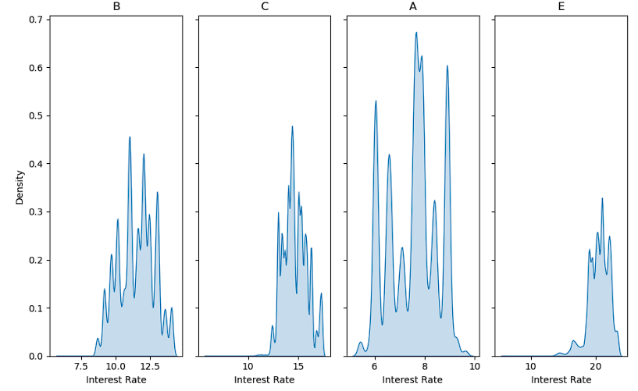
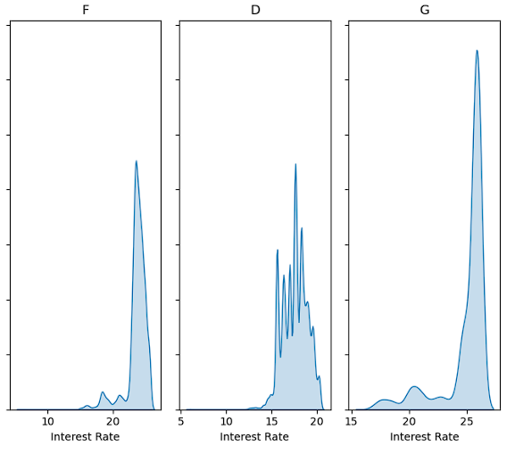
Exploratory Data Analysis
Most common occurrences of high-risk grade D, E, F, and G interest rates are in the range from 15% up-to 27%.
This finding is inline with (Claessens et al., 2018) that loan grades are a key factor in deciding the interest rate a borrower gets offered. Higher grades borrower would more likely to get lower interest rates, while lower grades face higher borrowing costs.

Slide 10
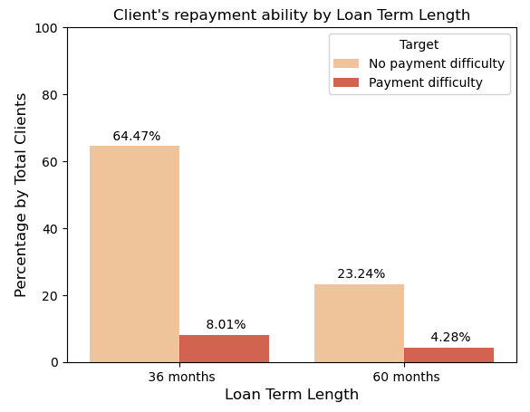
Exploratory Data Analysis
64.47% of borrower with good loans status are those who have 36 months of loan term, while the loan term of 60 months has 23.24% of borrower that are in good loans status.
Majority of borrower are in the loan term of 36 months, this suggest that there's lower chance of borrower to default because of the shorter term compared to 60 months, this would also suggest that the borrower who are in the 36 months loan term would be a fairly low-risk borrower.
Shorter term is more preferable among startups and small businesses, this is because newer businesses tend to have limited credit history and opt for shorter-term loans to build credit and access more favorable financing options in the future.

Slide 11
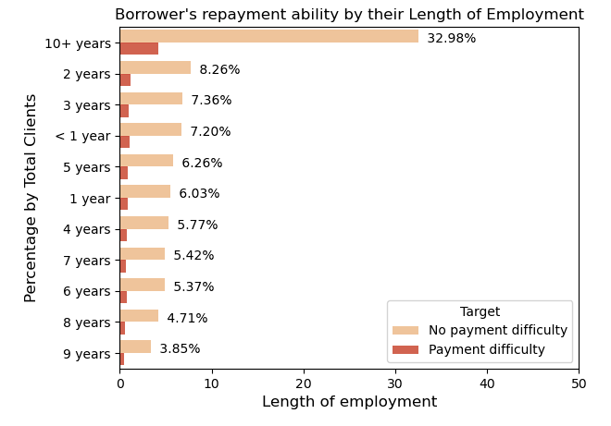
Exploratory Data Analysis
32.98% of borrowers with over 10 years of employment have the lowest rate of payment difficulties, suggesting they have a stable income, reducing default risk. This aligns with Borsi (2018), indicating longer employment tenure reduces default risk.
Borrowers with over 10 years of employment tend to avoid payment difficulties due to their increased financial stability. Additionally, their past credit history may boost confidence in taking out loans.
Borrowers with 2 years of employment, ranking second at 8.26% without payment difficulty, are likely in early career stages, often involving household responsibilities like starting families or planning major life events, requiring immediate or quick access to funds.

Slide 12
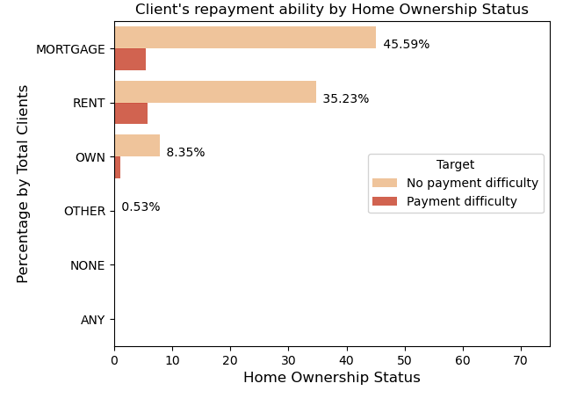
Exploratory Data Analysis
Mortgage reaching 27.80% are the highest percentage of clients that do not have payment difficulty, followed second Rent having quite an amount of margin by 10.36%. This suggest majority of borrower are those who are associated with greater financial stability while also highly susceptible to the likelihood of unforeseen financial challenges.
8.35% of borrower that do not have payment difficulty own a house, could mean that small portion of borrower have fully paid off their properties. This could also suggest that the borrower might be in the older side or closer to retirement which would potentially increase their risk of default.

Slide 13
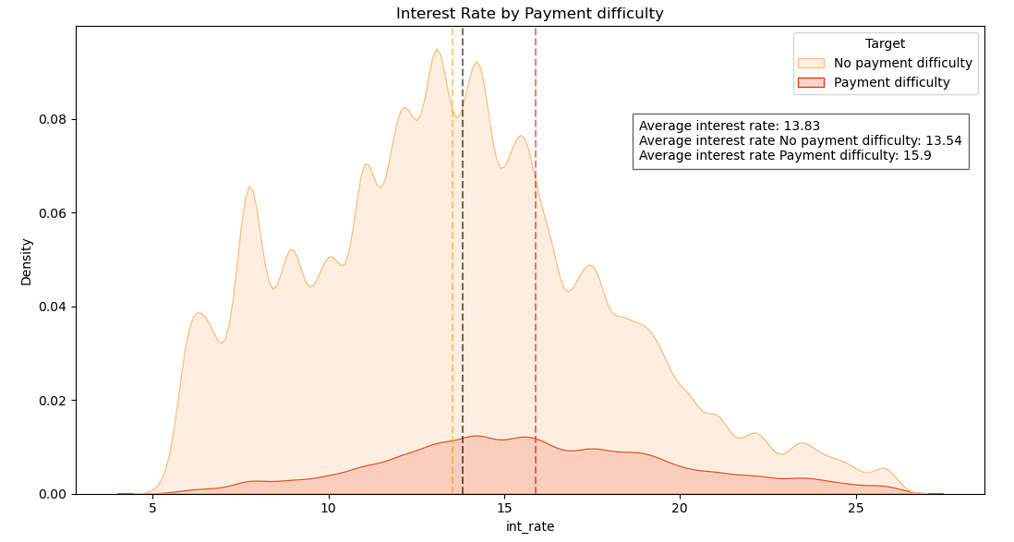
Exploratory Data Analysis
Based on study done by Bankrate.com, in 2024 the average interest rates for personal loans is 12.10%, while those who has excellent credit score having the lowest interest rates of 10.73% - 12.50%. For borrower with good credit score, the average rate is 13.50% – 15.50%. Borrower with lower credit score will pay a considerably higher average rate possibly reaching 32%.
The average interest rate for all borrowers is 13.83%, this would suggest that it is still considered to be good because it’s still in the range of 12.50% – 15.50%.
The average loan interest rate for all borrowers at ID/X Partners is still relatively good because it is in the range of 13% – 16%. The reason why the average interest rate for borrowers with bad loans status is higher than for borrower with good loans status is because the lower the borrower's credit score is, the higher the interest rates become to compensate for the increased risk the lender takes on.

Slide 14
Feature Engineering

Slide 15
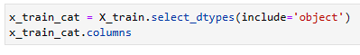
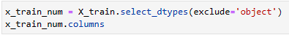
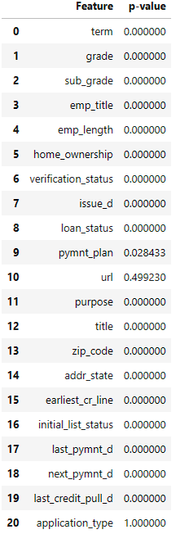
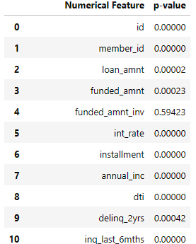
Feature Selection
Categorical Columns
Numerical Columns
Low cardinality (unique)
No null values
p-value < 0.05
Low cardinality (unique)
No null values
p-value < 0.05
correlation coefficient <= 0.7
There are 21 columns with dtypes ‘object’
P-value from chi-squared are used in order to select which columns is to be dropped.
Based on p-value found, there are a total of 12 columns dropped based on their p-value and cardinality.
With excluding dtypes ‘object’ there are a total of 32 columns to be tested.
P-value from ANOVA are used in order to select which columns is to be dropped.
There are 5 column dropped based on their p-value and correlation coefficient.

Slide 16
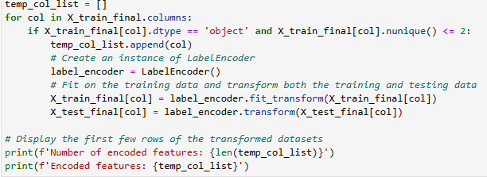
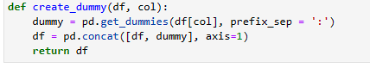
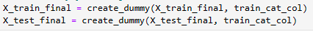
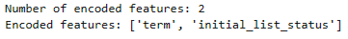
Feature Encoding
Label Encoding
One Hot Encoding
Categorical features are mapped with boolean values (True) & (False), with 0 represents the absence, and 1 represents the presence of that particular category.
Label encoding is used on categorical columns with only 2 or less unique values.
Based on the result, there are 2 columns that meet this criteria which then replaced with 0 and 1.
One hot encoding are applied to categorical columns with more than 2 unique values.
Based on the result, there are 8 columns that meet this criteria which then converted to Boolean value, the original columns of each selected columns will then promptly dropped.

Slide 17
Modelling

Slide 18
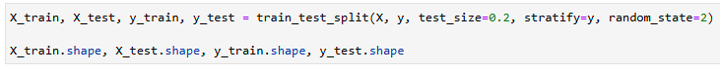
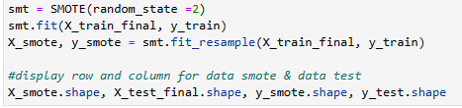
Modelling
Splitting Dataset
80% training : 20% testing
Using train_test_split, dataset is split into two part, train and test.
Train dataset will be used to train the model in order to be able to predict with new foreign data.
Test dataset will be used to represent new foreign data.
SMOTE
SMOTE works by creating synthetic examples from the minority class by interpolating between existing minority class instances.
SMOTE is used because standard machine learning algorithm such as Decision Tree and Logistic Regression have a bias towards the majority class, and they tend to ignore the minority class.
Oversampling technique that helps to improve the performance of machine learning models by balancing the class distribution, particularly useful when the minority class is underrepresented.

Slide 19
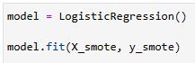
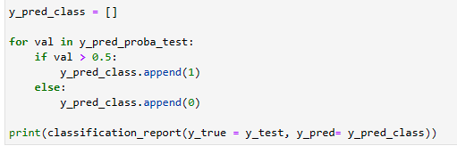
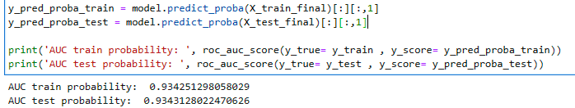
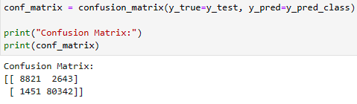
Logistic Regression
Logistic regression is a statistical model used for binary classification tasks. It estimates the probability that a given input belongs to a certain class using a logistic function, which maps inputs to a value between 0 and 1. This algorithm is popular for its interpretability and efficiency in modeling linear relationships between features and outcomes.
Model Fitting
Classification Report
Model fitting, is used to create model that will describes the relationship between features and outcomes in a dataset, allowing the model to predict the probability of an observation belonging to a particular class in binary classification tasks.
Out of all the loan statuses predicted, the model is able to predict that a client will not have payment difficulty with 97% prediction correct most of the time.
Recall values of 98% indicates that the model is able to correctly identify 98% of the clients who do not have payment difficulty.
F-1 score of 97% indicates that the model has a good balance between precision and recall for both classes and is effective at classifying both cases of payment difficulty and no payment difficulty.
ROC/AUC
Confusion matrix
True positive have the value of 8873, this represent that out of all prediction done by the model, only 8873 correctly predicted as positive.
True negative have the value of 79777, this represent that out of all prediction done by the model, only 79777 correctly predicted as negative.
Higher AUC value indicates better class separation, as the model is able to distinguish between the positive and negative classes more effectively.
0.9 AUC score from both train & test probability suggest that the model performance considered to be very good, and is effective at distinguishing between the positive and negative classes.

Slide 20
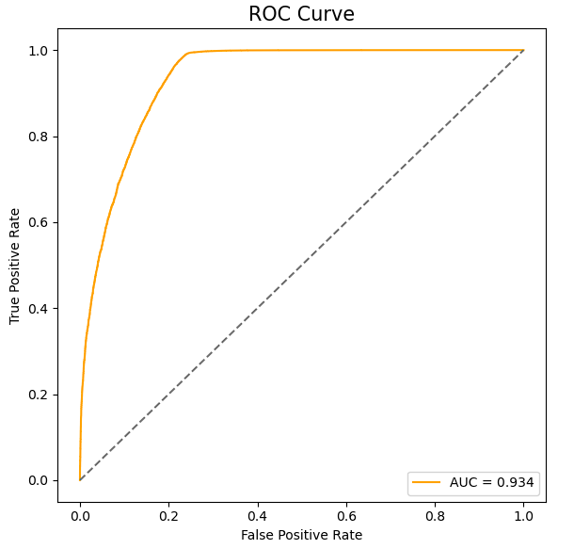
Exploratory Data Analysis
The ROC AUC score is the area under the ROC curve. It tells how well a model can produce relative scores to discriminate between positive class and negative class instances across all classification thresholds.
The ROC AUC score ranges from 0 to 1, where 0.5 indicates random guessing, and 1 indicates perfect performance.
AUC score = 0.934 nearing 1 would indicates that the model has a good performance.

Slide 21
Output

Slide 22
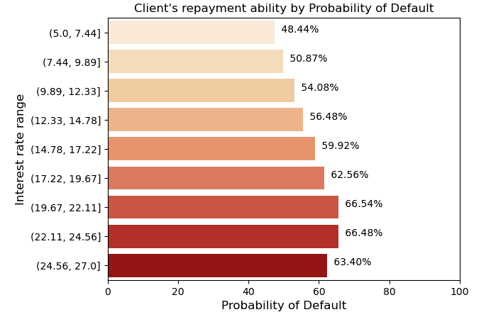
Logistic Regression
- Borrower whose interest rate in the range of 19.67% - 24.56% have the highest probability to default. This would suggest that based on their previous credit history and the resulted interest rate given to them, company can expect that there is 66.48% probability at most that the loans will be defaulted.
Even at the lowest interest rate recorded which is in the range of 5% – 7.44%, the probability of loans defaulted is quite high reaching 48.44%. This would suggest that the company need strengthen the criteria needed for borrower loans application to be accepted.
The result also suggest the need of risk mitigation plan by the company that would counter potential loss.

Slide 23
Recommendation

Slide 24

Recommendation
By using a variety of machine learning techniques and data points, loan companies can create a more effective credit scoring models that accurately predict a borrower's ability to repay a loan.
Company should strive towards the objective that would ensure borrowers can manage their debts by filtering out those at high risk of delinquency.
By getting more external data, such as utility bills, rental payments, or even social media activity, the company as the lender can create a more holistic picture of a borrower's financial responsibility.
https://github.com/UrsaG7/ID-X_Partners_credit
Thank You!

